Slide 1

May 30 Videoconference
Arnie Schneider
Brett Tambling
Scheller College of Business

Slide 2
MGT8803 Business Fundamentals for Analytics Video Conference Call #4 Video Call Agenda
Course Update
Financial Accounting Questions from the Forum Hold homework related questions until after video review
Sample Managerial Accounting Problems From Topics 1 and 2.

Slide 3
MGT8803 Business Fundamentals for Analytics Video Conference Call #4 Course Update
The Financial Accounting Homework assignment closed Wednesday night. Results will be reviewed on Sunday June 2 by BlueJeans recording that will be posted to the Canvas website. Students will be alerted by eMail when the recording is ready for review.
The Managerial Accounting graded homework assignment will open on Tuesday June 4 and is due on Wednesday June 12.
This week focus on completing Managerial Accounting topics 3 and 4.
The next Videoconference call will be on Thursday June 6

Slide 4
MGT8803 Business Fundamentals for Analytics Video Conference Call #4 Managerial Accounting
Financial Accounting Follow-up Questions from Piazza Forum Discussions:
Are marketable securities always current assets? At times they were referred to as “short-term” marketable securities. Was that just to help us or are they referred to both ways? What are these things exactly?
Are mortgage payable and notes payable generally long-term liabilities except when you see something added like “current portion of”? How else might it appear? Will it always be obvious like that?
Can you discuss Goodwill a little more. How do the mechanics of this work with buying another company? Any strategy for how to handle this?
When revenues aren’t revenues and expenses not expenses! Commonly missed.
Current Assets: | Current Liabilities:
Deferred expenses (we prepaid some expenses) | Deferred revenues (we got paid for ‘unearned’ work)

Slide 5
MGT8803 Business Fundamentals for Analytics Video Conference Call #4 Managerial Accounting
Overview of Cost Concepts
Product vs. Period Costs
Cost of Goods Manufactured
Cost of Goods Sold
Overhead Allocation Methods
Plant-wide Rate (Direct labor Hours)
ABC Method

Slide 6
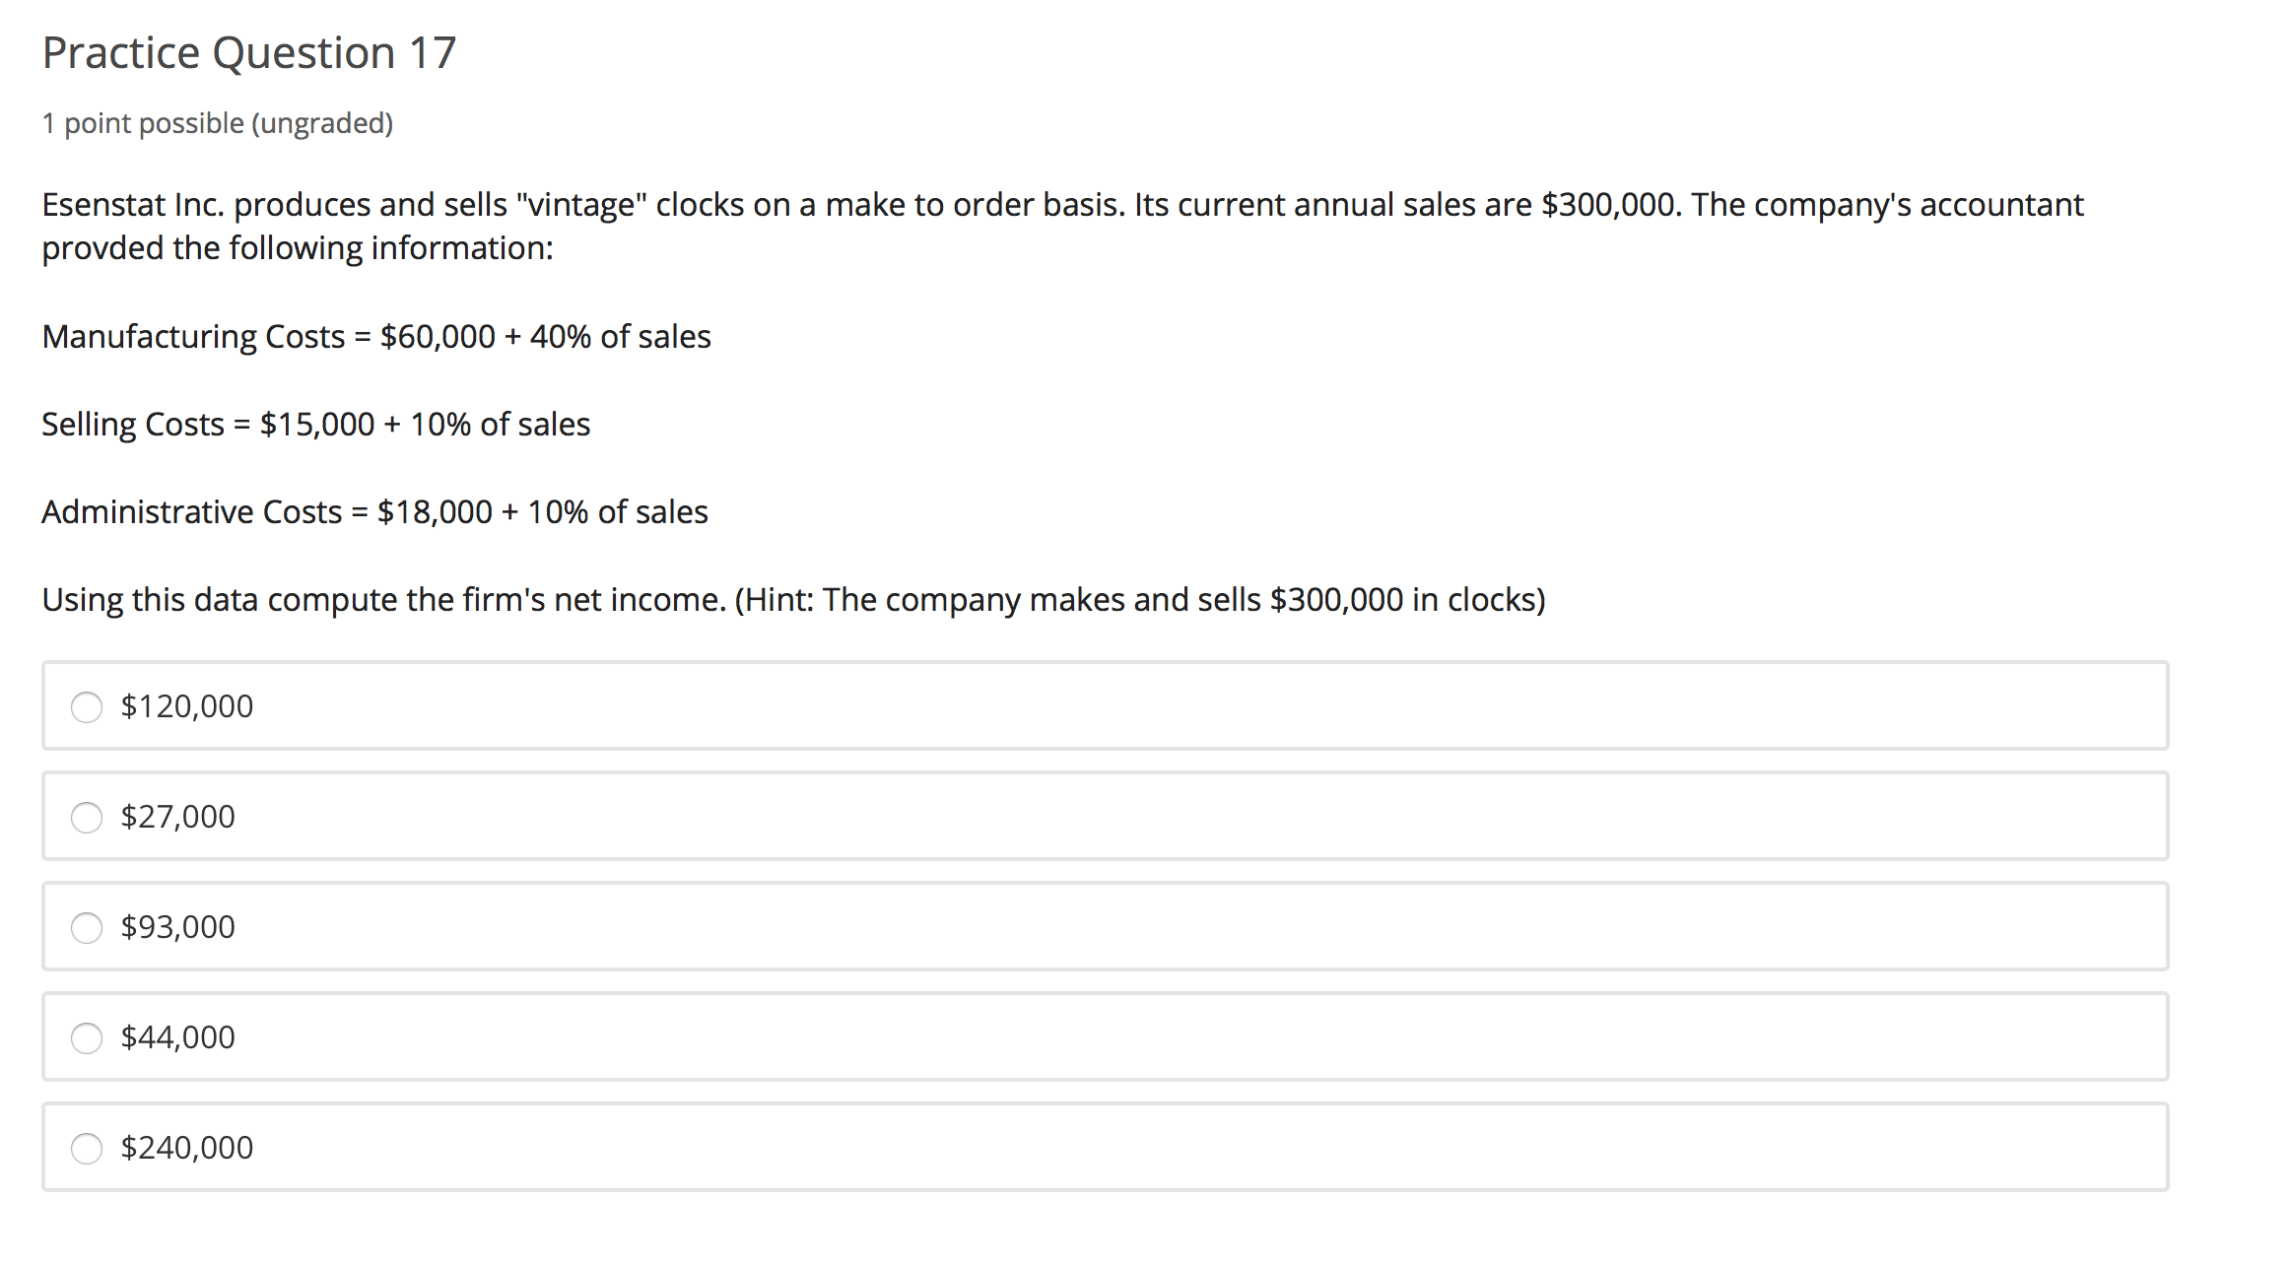
MGT8803 Business Fundamentals for Analytics Video Conference Call #4 Managerial Accounting
MFG Costs = $60,000 + (.4*$300.000)
= $180,000
Selling Costs = $15,000 + (.1*$300,000)
= $45,000
Adm Costs = $18,000 + (.1*$300,000)
= $48,000
Net Income
Sales $300,000
COGS (180,000)
GM $120,000
S,G,&A $ 93,000
Net Income $ 27,000

Slide 7
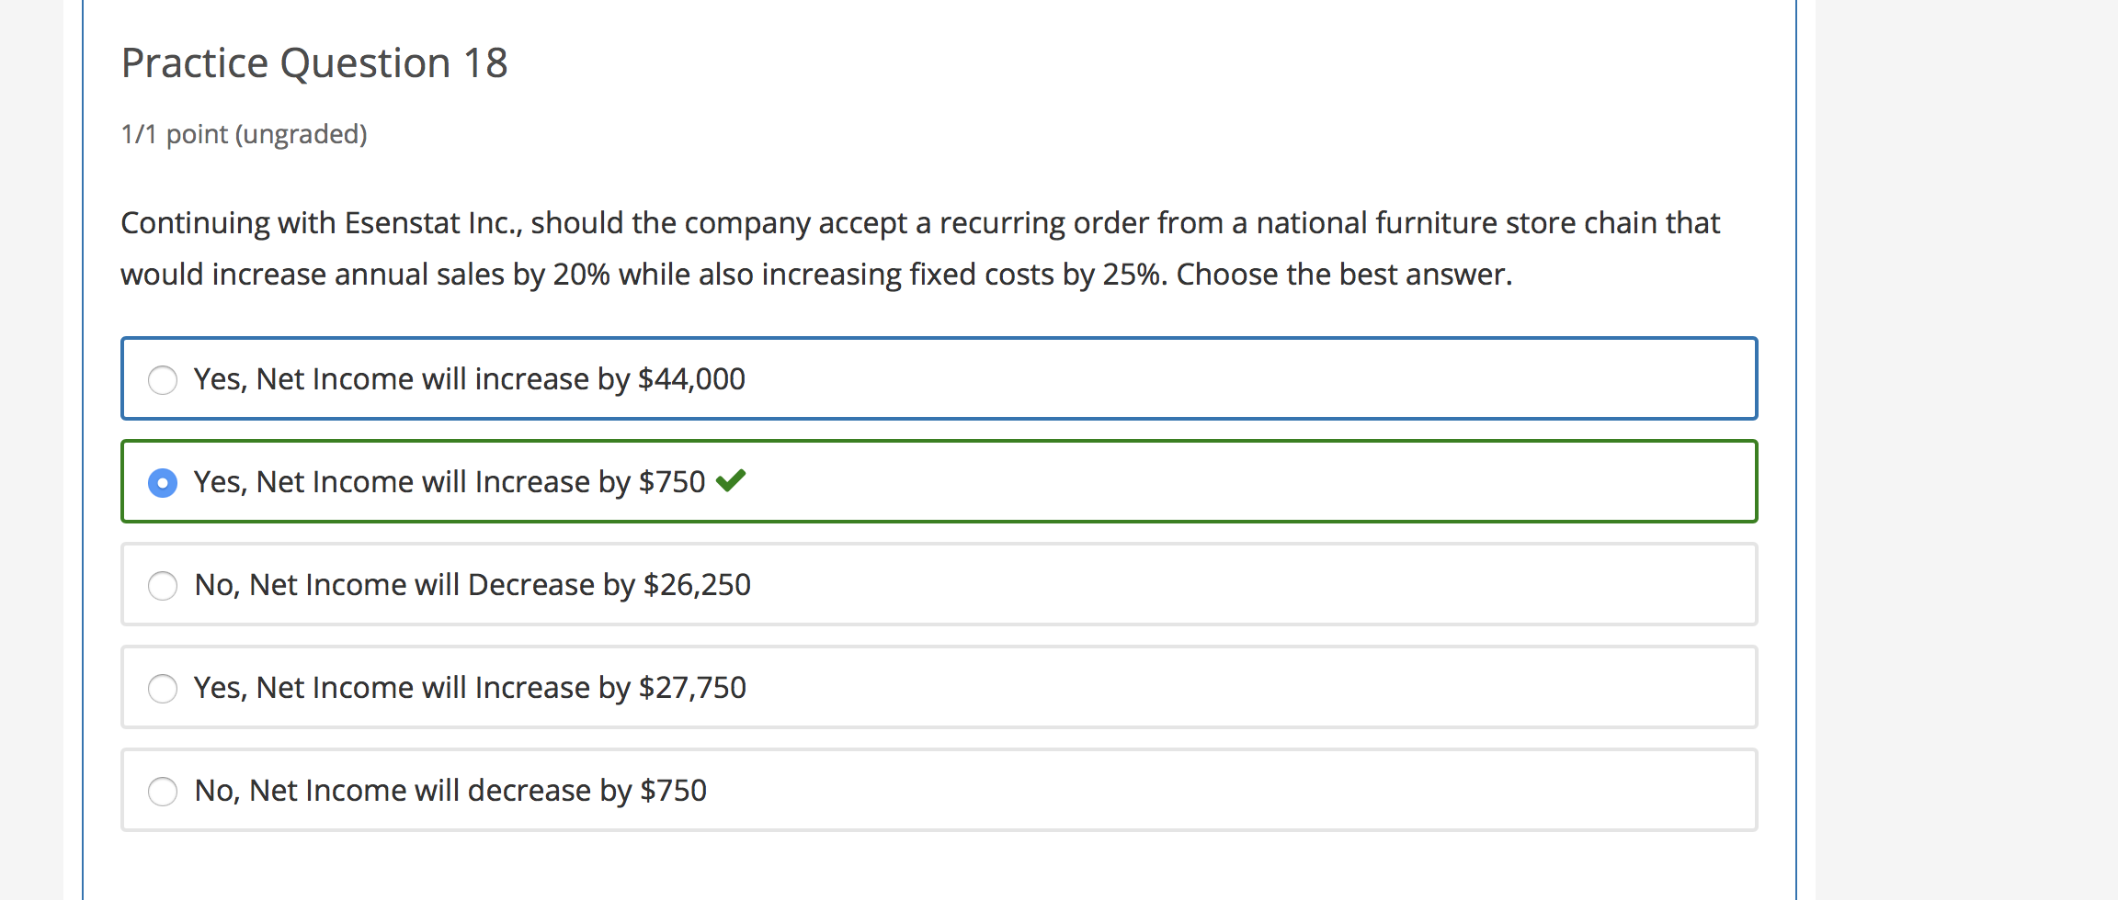
MGT8803 Business Fundamentals for Analytics Video Conference Call #4 Managerial Accounting
Increase in Sales = $60,000
Increase in Fixed Costs ($23,250) (60,000+15,000+18,000)*.25
Increase in Var. Costs ($36,000) (.6*$60,000)
Profit Increase (decrease) $750

Slide 8
Video Conference Call #4 New Problem Exercise on Cost Concepts
Asnien Outfitters makes Artic Hotsuits. The general manager has a special board on his office wall where he writes key statistics. For March, the board shows the following:
Also he heard the sales manager brag about selling 22,000 suits this month.
Questions:
1. From the data, what was the cost of producing an Artic Hotsuit in March?
2. What was cost of goods sold in March?
What are the total product and period costs that will appear on Asnien Outfitters’ income statement for March?
Production output | 25,000 suits
Materials costs | $50,000
Direct labor costs | 2,000 hours at $10 per hour
Factory overhead | $2 per outfit plus $40,000 per month
Selling expenses | $1 per outfit sold plus $50,000 per month

Slide 9
Video Conference Call #4 Exercise on Cost Concepts
Asnien Outfitters makes Artic Hotsuits. The general manager has a special board on his office wall where he writes key statistics. For March, the board shows the following:
He heard the sales manager brag about selling 22,000 suits this month.
Questions:
From the data, what was the cost of producing an Artic Hotsuit in March?
$50,000 + 2,000($10) + [$2(25,000) + $40,000] = $160,000
$160,000 / 25,000 = $6.40
Production output | 25,000 suits
Materials costs | $50,000
Direct labor costs | 2,000 hours at $10 per hour
Factory overhead | $2 per outfit plus $40,000 per month
Selling expenses | $1 per outfit sold plus $50,000 per month

Slide 10
Video Conference Call #4 Exercise on Cost Concepts
Asnien Outfitters makes Artic Hotsuits. The general manager has a special board on his office wall where he writes key statistics. For March, the board shows the following:
He heard the sales manager brag about selling 22,000 suits this month.
Questions:
2. What was the cost of goods sold in March?
$6.40 per suit x 22,000 suits = $140,800
Production output | 25,000 suits
Materials costs | $50,000
Direct labor costs | 2,000 hours at $10 per hour
Factory overhead | $2 per outfit plus $40,000 per month
Selling expenses | $1 per outfit sold plus $50,000 per month

Slide 11
Video Conference Call #4 Exercise on Cost Concepts
Asnien Outfitters makes Artic Hotsuits. The general manager has a special board on his office wall where he writes key statistics. For March, the board shows the following:
He heard the sales manager brag about selling 22,000 suits this month.
Questions:
3. What are the total product and period costs that will appear on Asnien Outfitters’ income statement for March?
Product costs: $140,800 (cost of goods sold)
Period costs: ($1 per suit x 22,000 suits) + $50,000 = $72,000
Production output | 25,000 suits
Materials costs | $50,000
Direct labor costs | 2,000 hours at $10 per hour
Factory overhead | $2 per outfit plus $40,000 per month
Selling expenses | $1 per outfit sold plus $50,000 per month

Slide 12
MGT8803 Business Fundamentals for Analytics
Video Conference Call #4 ABC Method of Overhead Calculation
In manufacturing baseball bats, Chana Company's plant used 360 direct labor hours, 450 machine hours, and 23 setups. The following overhead costs were taken from the factory accounts:
Overhead expenses: Volume of activities:
Machining center $175,000 25,000 machine hours
Setup center 66,000 100 setups
Total $241,000 5,000 direct labor hours
The plant was using a factory-wide overhead rate based on direct labor hours. A new ABC system will use machine hours in the Machining Department and number of setups in the Setup Department as cost drivers. By what amount would the amount of overhead costs assigned to baseball bats differ between the prior system and the ABC system?
Using Direct Labor Hours
Overhead rate = $241,000/5000 = $48.20/hr
Bats used 360 hours direct labor
So OH allocation = 360*$48.20 = $17,352
Using ABC
Mach Center: ($175,000/25,000) * 450 hrs = $3,150
Setup Center: ($66,000/100) * 23 = $15,180
Total OH Allocated = $18,330
Difference = $18,330 - $17, 352 = $978

